Slide 1
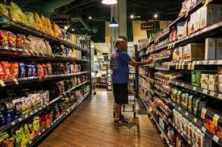
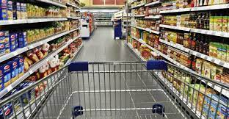
Online Grocery shop

Slide 2
Presentation on
“online Grocery shop “
Presented By:
Ms. Jagtap Prajakta Sukhadev- 327
Ms. Dhanvde Sayli Popatraw- 310
Ms. Gadekar Muyuri Subhash -314
Ms. Ghatge Surabhi Anil-318
Guided By:
Prof S.S Nimbalkar
Department of computer Enginering

Slide 3
Introduction :
*It integrates the benefits of an ordering product with the convenience of an online excitement and going with technology minus the commuting hazard and expense
*It will usher in the immense flexibility and sophistication in the existing manual platform structure with the perfect blend synchronous and asynchronous interaction
*It provides means of collaborative E-ordering for customers
*Online Grocery Market is a form of ecommerce that allows consumers to directly buy fresh food staffs or produce from a seller over the internet.
*An online grocery shop evokes the physical analogy of buying produce like it is done in a local market.

Slide 4
MODULES: Customer module *View Products *Product Booking *Given Feedback *View Product Booking

Slide 5
MODULES: Administrative module * Manage Products *Manage Booking *Manage Customers *Manage Feedback

Slide 6
Administrative modulE - *Administrative module is provided for the sake of administrators to manage the site and update the content at regular intervals *The major operation included in the module are: 1. Create and Maintain product Categories 2.View the product available 3.Update product available 4.Remove the product 5.View Customer information and Booking

Slide 7
Customer modulE - *This module is meant for customers ,where a user logging into his/her owns account will view this panel
*The major operation included in this module were
*View all available product and its price ,description and other details etc.
*View our booking
*View and cancelling of the product booking
* Send Feedback

Slide 8
purpose -
To manage the online grocery product ordering .Its helps to customer to book product form anywhere .
Also make payment on delivery .Its helps to people to books desired products at their prefer time

Slide 9
scope -
The project has a wide scope ,as it is not intended to a particular organization .The project is going to develop generic software ,which can be applied by an business organization .More over it provides facility to its customer .Also the software is going to provide a huge amount of summary data

Slide 10
Software Used -
* Pythgon interpreter
*Chrome and any other browser

Slide 11
frontend -
*HTML
*CSS
* Bootstrap

Slide 12
Backend –
*python Django
*SQLLITE (DATABASE)

Slide 13
System design –
Unified Modeling Language:
*UML stands for unified modeling language .Its is a third generation method for specifying visualization and documenting the artifacts of an object oriented system under development .Object modeling is process by which the logical object in real world are represented by actually object in program

Slide 14
* The Unified Modelling Language Encompasses a no of models * Use case diagrams * Class diagrams * Sequence diagrams

Slide 15
Use case diagram: * Use case diagram consist of use cases and actors and shows the interaction between them * The main purpose is to show the interaction between the use case and the actor * To represent the system requirement from users perspective * the use cases are the function that are to be perform in the module

Slide 16
Use Case Diagram between ADMIN and SYSTEM :
Manage products
Manage feedback
Manage Booking
Manage Users

Slide 17
Use Case Diagram between ADMIN and SYSTEM :
Booking
Cancels
Search
Feed back

Slide 18
Sequence Diagram : The purpose of Sequence diagram is to show the flow of the functionality through a use in case .In the other worlds we call it a mapping process in terms of data transfers form the actor through the corresponding objects

Slide 19
Sequence Diagram -

Slide 20
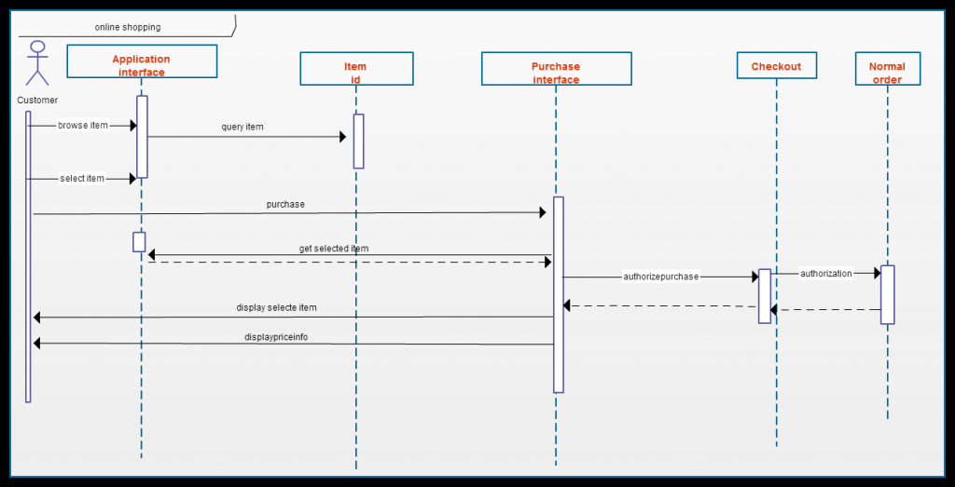

Slide 21
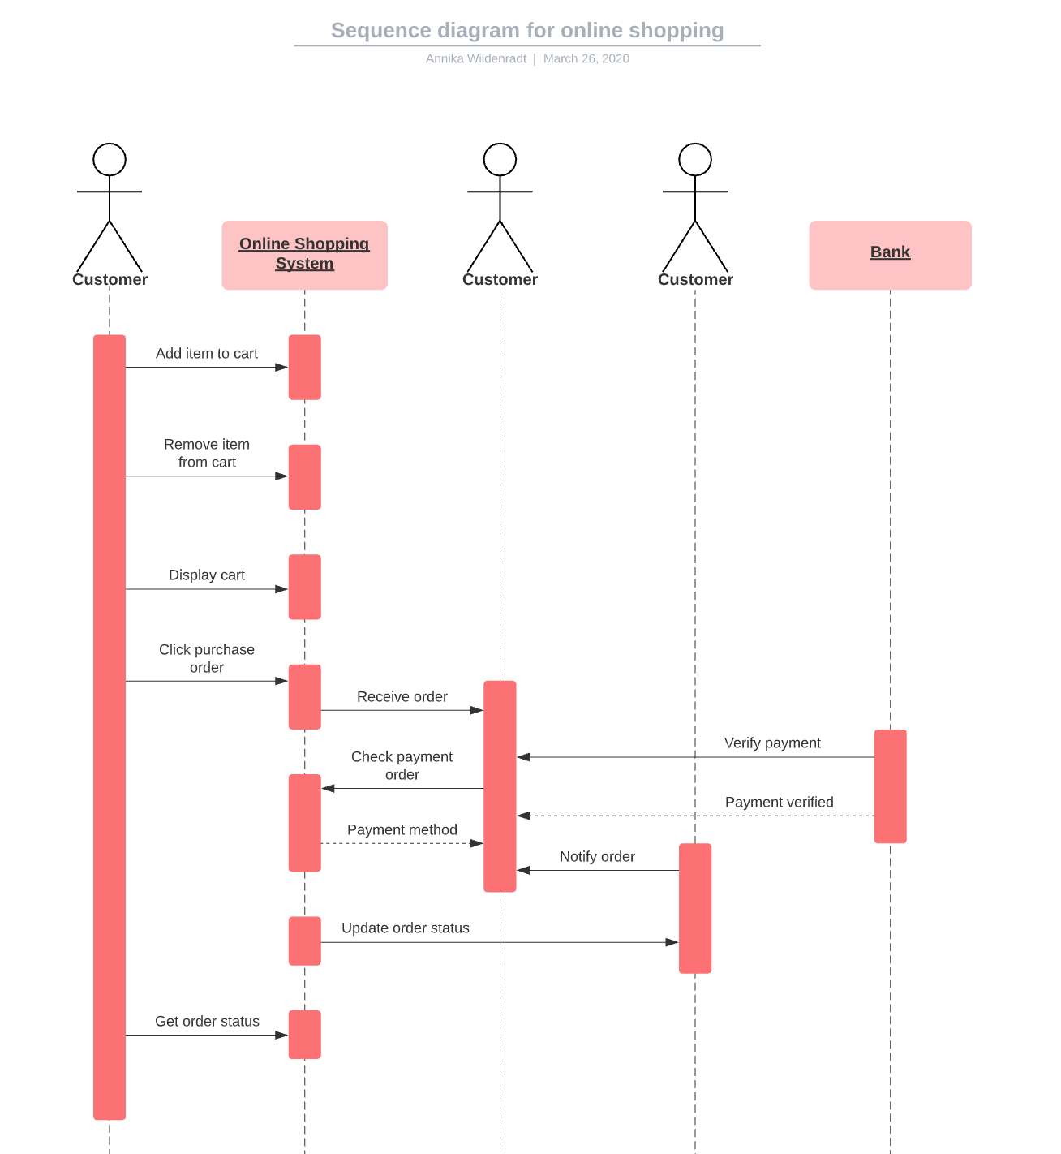

Slide 22
Data flow Diagram

Slide 23
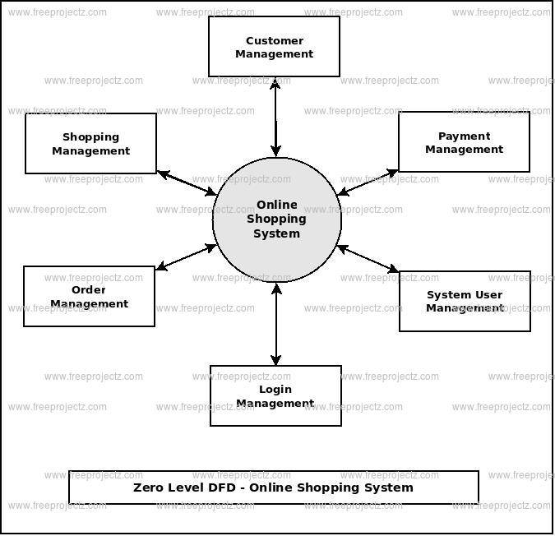

Slide 24
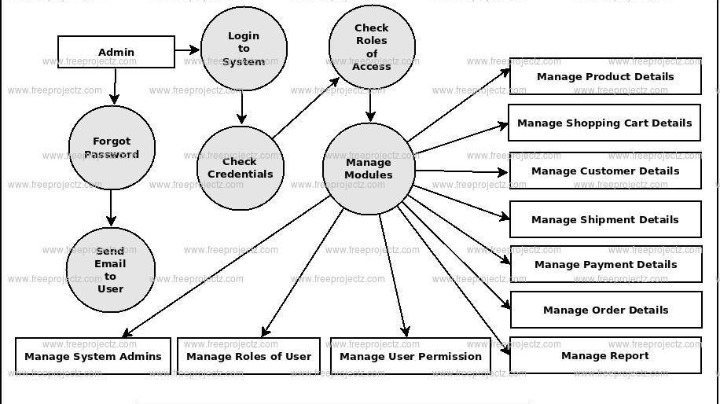

Slide 25
ER-Diagram

Slide 26
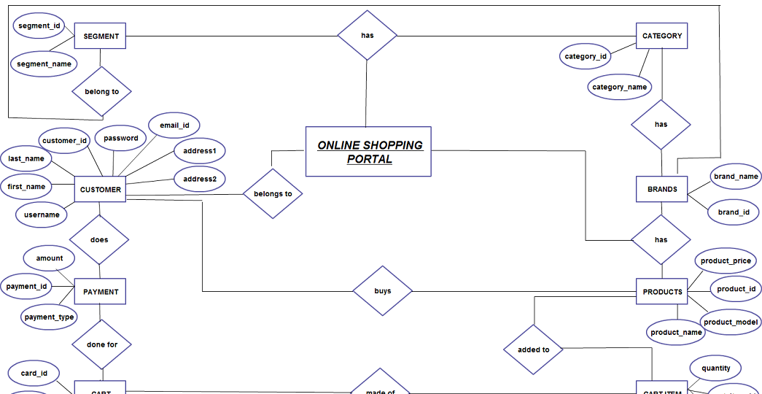

Slide 27
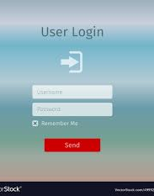
User login page :

Slide 28
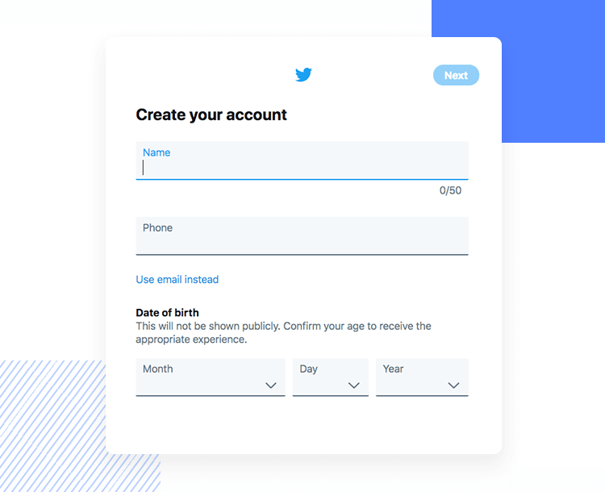
user signup page : page :

Slide 29
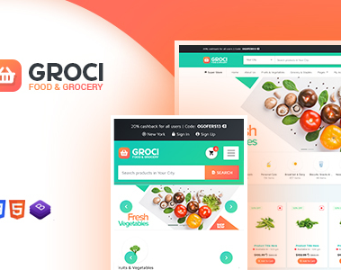
Product categories page :

Slide 30
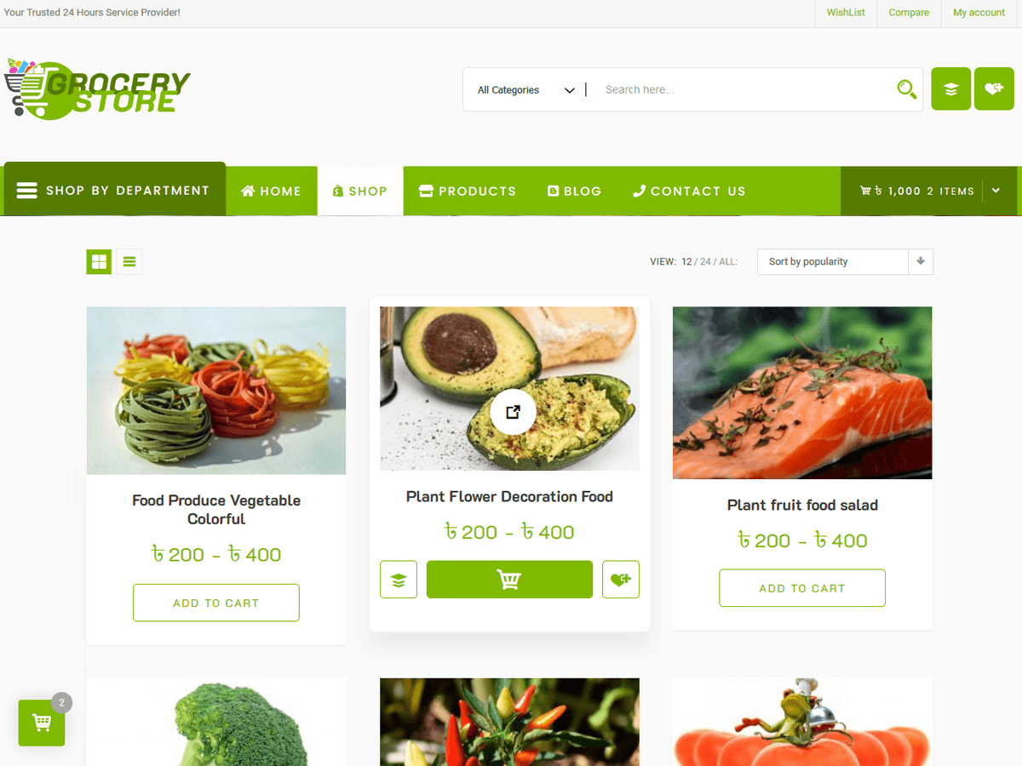
View cart page :

Slide 31
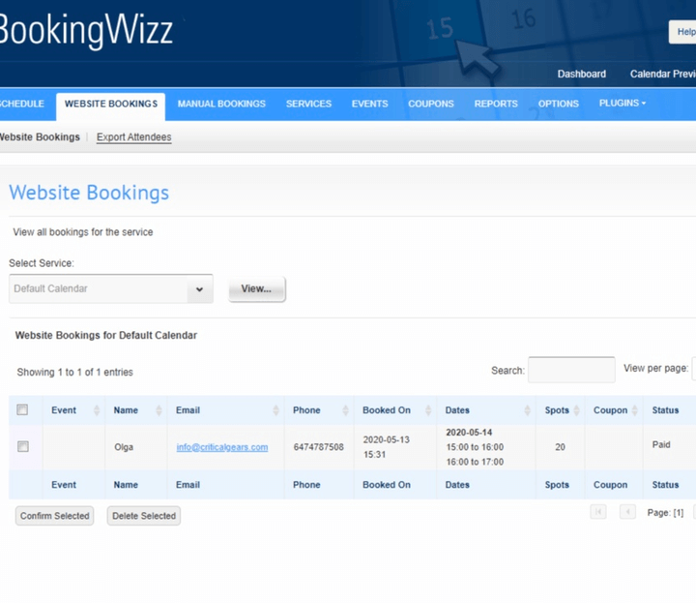
payment page :

Slide 32
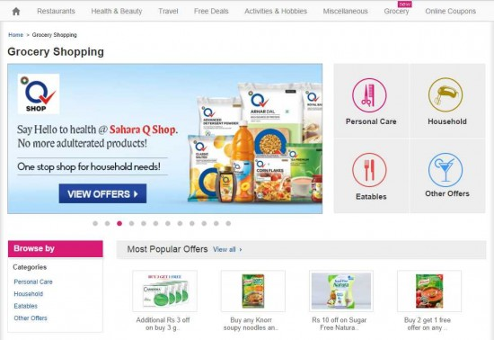
View products page :

Slide 33
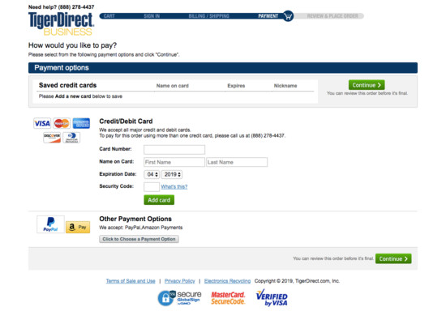
Payment page :

Slide 34
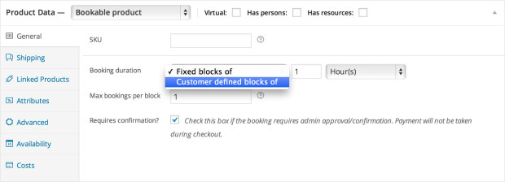
view booking page:

Slide 35
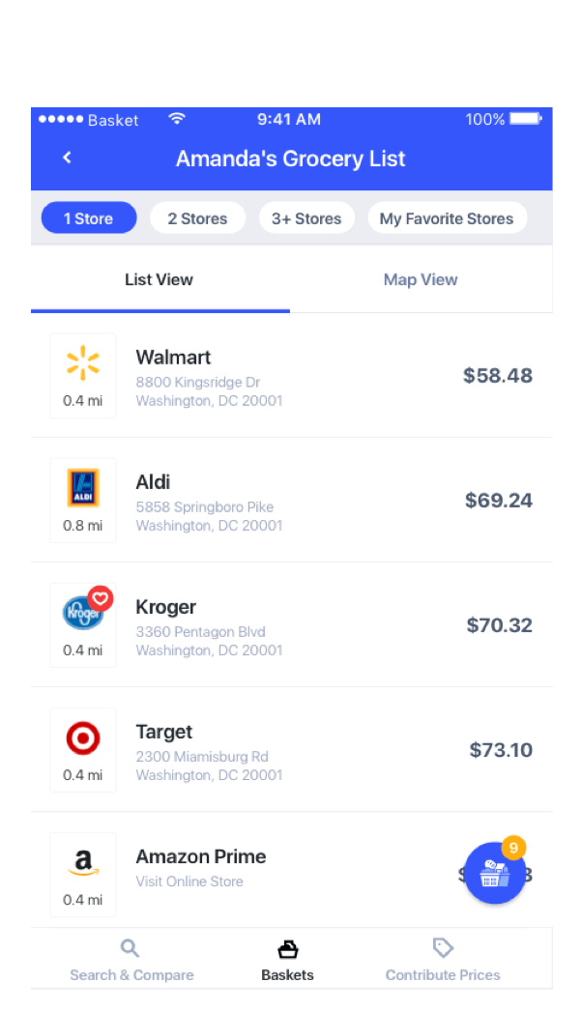
View page user products :

Slide 36
View cart page :

Slide 37
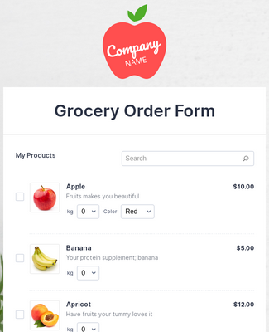
Booking Page

Slide 38
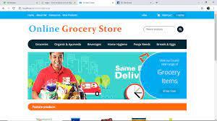
View profile page :

Slide 39
conclusion :
Technology has made significant progress over the years to provide consumers a better online shopping experience and will continue to do so for years to come. With the rapid growth of products and brands, people have speculated that online shopping will overtake in-store shopping.

Slide 40
thank you

